Slide 1


KRAKEN QGIS PLUGIN • USER MANUAL
Coverage Prediction Module
User Manual & System Architecture Guidelines for RSRP Signal Propagation Modeling directly on QGIS Canvas
Propagation Model
Selection Mode
Visualization
5 Different Model Supported
Interactive Canvas Tool
Dynamic & Adjustable RSRP Range
Kraken © 2026 | akanipatra@gmail.com

Slide 2
SYSTEM ARCHITECTURE
FEATURE OVERVIEW & CORE ENGINE
COVERAGE ENGINE WORKFLOW
CORE PYTHON MODULES
Simulates and estimates RSRP signal coverage or Path Loss directly within the QGIS workspace. Integrates real-time antenna tilt, sector pattern, power settings, and elevation terrain.
coverage_prediction_dialog.py
Main Qt UI controller, parameters loader, and settings manager.
Non-Modal GUI Dialog: Dynamic setup with window minimize/maximize capabilities.
coverage_prediction_map_tool.py
Canvas map tool handling click identification on Main_GCell vector layer.
QGIS Map Tool: Pointing hand tool bound to layer feature identification.
Visual Glow Layering: Triple RubberBand outline glow on map canvas.
selected_cell_predict_*.py
Propagation execution backends (COST-231, Terrain, UMa/UMi, SPM).
Kraken © 2026 | akanipatra@gmail.com

Slide 3
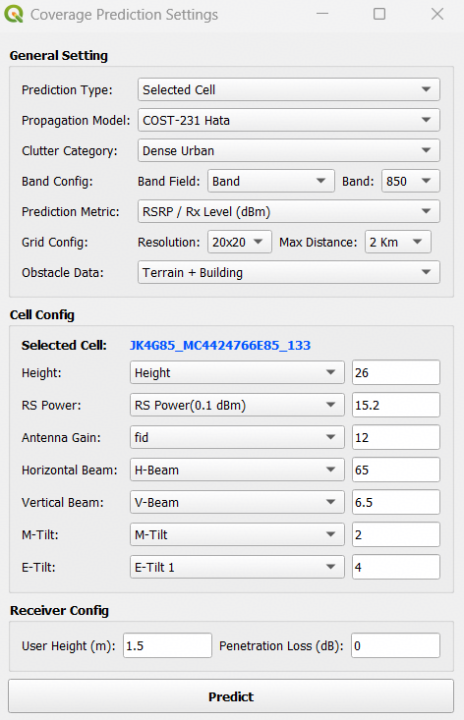
WORKFLOW STEP 01
INTERACTIVE CELL SELECTION
01
ACTIVATE MAP TOOL
Set Prediction Type to Selected Cell. The cursor transforms into a Pointing Hand on map canvas.
02
CLICK TARGET SECTOR
Click any sector wedge on GIS map canvas. The system identifies the nearest feature from layer.
Main_GCell
03
MULTI-LAYER GLOW EFFECT
Selected cell geometry is highlighted with 3-tier RubberBand glow (Outer Cyan Halo, Mid Aura, Solid White Core).
GUI Control Dialog with Auto-Populated Parameters
Kraken © 2026 | akanipatra@gmail.com

Slide 4
WORKFLOW STEP 02
GENERAL SETTING PARAMETERS
PROPAGATION MODEL
CLUTTER CATEGORY
BAND CONFIGURATION
Select signal attenuation algorithm:
Defines environmental loss environment:
Map sector frequency bands dynamically:
•
COST-231 Hata
Dense Urban
Urban
Sub Urban
Automatically queries distinct values from selected field (e.g. 850, 1800, 2100 MHz).
•
Path-Specific Terrain
•
UMa & UMi Model
Rural
•
Standard Propagation
•
Free Space Path Loss
PREDICTION METRIC
GRID & RESOLUTION
OBSTACLE DATA
Switch prediction calculation target:
Configure grid step and radius:
Incorporates line-of-sight obstacles:
• RSRP / Rx Level (dBm)
• Path Loss (dB)
Resolution: 10x10, 20x20, 50x50m
Max Distance: 2 Km, 5 Km, 10 Km, 20 Km
• Terrain Only (DEM)
• Terrain + Building (DSM)
Kraken © 2026 | akanipatra@gmail.com

Slide 5
WORKFLOW STEP 03
CELL & RECEIVER CONFIGURATION
CELL FIELD AUTO-MAPPING
RECEIVER CONFIG
The plugin auto-detects sector attributes from the vector layer based on smart keyword matching:
User Height (m)
1.5 m (Default)
Parameter | Target Mapping | Fallback Keywords
Height | Antenna Height (m) | height, antenna_height, hgt
RS Power | TX Power (0.1 dBm) | rs_power, power, tx_power
Antenna Gain | Gain (dBi) | antenna_gain, gain, ant_gain
Beams (H/V) | 3dB Beamwidth (°) | hbeam, vbeam, bw_h, bw_v
Tilts (M/E) | Mechanical & Electrical | m_tilt, e_tilt, mech_tilt
Penetration Loss
0 dB (Outdoor)
In Selected Cell mode, numerical input fields remain fully editable, allowing users to perform custom "What-If" tilt or power adjustment simulations.
Kraken © 2026 | akanipatra@gmail.com

Slide 6
PROPAGATION INTELLIGENCE
SUPPORTED PROPAGATION MODELS
COST-231 HATA MODEL
PATH-SPECIFIC TERRAIN MODEL
Standard Urban / Sub Urban
Hilly / Mountainous Terrain
Extended Hata model suited for cellular communications between 1500 MHz to 2000 MHz. Calculates path loss based on base station height, mobile height, and urban density factors.
Extracts terrain elevation profiles along the radio path directly from DEM rasters to compute diffraction loss over obstacles and mountain ridges.
3GPP UMA & UMI MODELS
STANDARD PROPAGATION MODEL (SPM)
Urban Macro / Micro
Calibrated Macro Cells
3GPP TR 38.901 standard propagation model for 5G NR and 4G LTE. Differentiates between Urban Macro (high BS elevation) and Urban Micro (street canyon level).
Empirical formulas tuned for general macro cell planning, balancing diffraction, clutter attenuation, and distance slope factors.
Kraken © 2026 | akanipatra@gmail.com

Slide 7
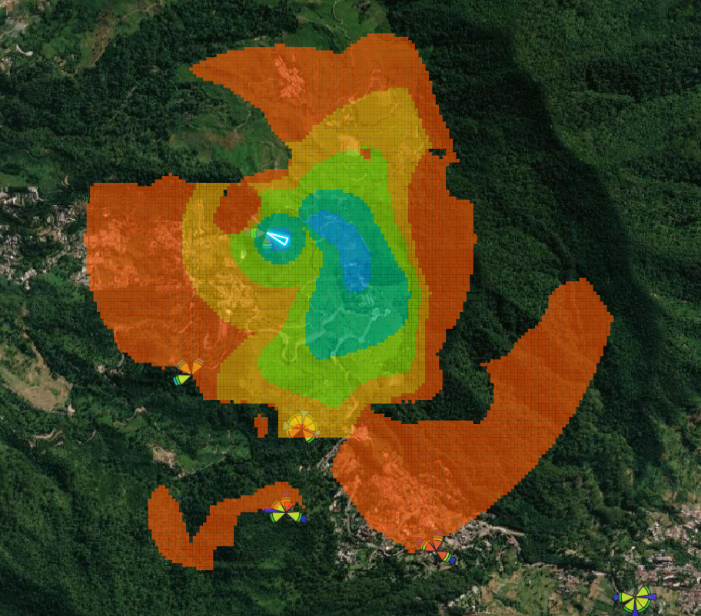
WORKFLOW STEP 04
EXECUTION & SIMULATION RENDERING
TRIGGER SIMULATION
Click the bold Predict button at the bottom of the dialog. The plugin processes raytracing, 3D pattern attenuation, and path loss equations.
DYNAMIC HEATMAP LAYER
Generates a temporary memory raster/grid layer on the QGIS map canvas styled with standard RF color gradations (Blue = Excellent RSRP, Green = Good, Orange/Red = Edge Coverage).
TERRAIN SHADOWING OUTPUT
Notice how the predicted heatmap respects terrain contours, creating natural signal blockages and hill shadows on the satellite backdrop.
Path-Specific Terrain Model RSRP Heatmap Visualization
Kraken © 2026 | akanipatra@gmail.com

Slide 8
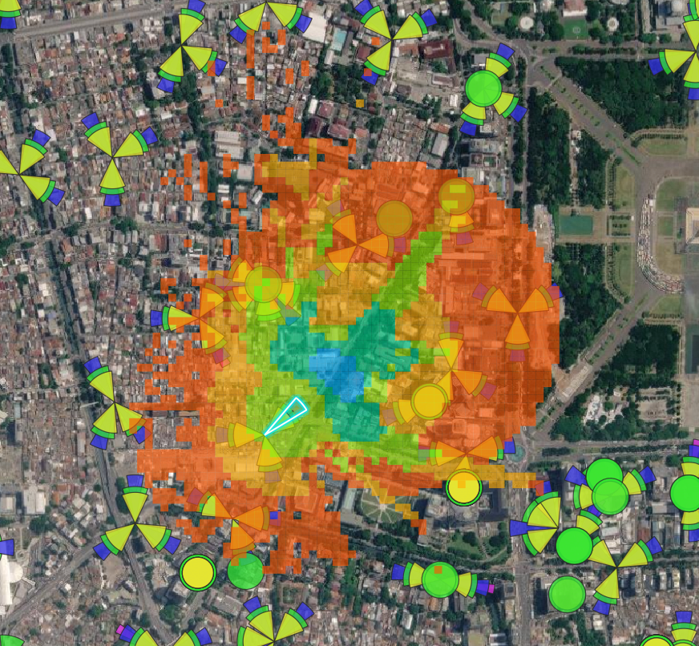
URBAN COVERAGE EXAMPLE
DENSE URBAN PREDICTION (TERRAIN + BUILDING DSM)
BUILDING SHADOWING & DIFFRACTION
When Terrain + Building (DSM) is enabled, signal loss accounts for urban building heights, causing sharp attenuation behind high-rise structures and along street canyons.
MICRO-CELL CLUTTER INTERACTION
High-resolution prediction grids capture fine-grained signal drops across dense building blocks while reflecting main lobe dominance from the target sector antenna.
MULTI-SECTOR INTERFERENCE CONTEXT
Overlaid GCell sector wedges clearly illustrate serving sector alignment versus surrounding neighbor cells in high-density metropolitan zones.
Dense Urban Prediction (Terrain + Building DSM Model)
Kraken © 2026 | akanipatra@gmail.com

Slide 9
OPERATIONAL CHECKLIST
BEST PRACTICES & TROUBLESHOOTING
VERIFY VECTOR LAYER
CHECK TERRAIN DATA
GRID RESOLUTION OPTIMIZATION
main_gcell_layer_id
For Path-Specific Terrain predictions, verify that DEM/DSM rasters are loaded in the current QGIS project.
Use 50x50 resolution for fast macro-cell checks, and 10x10 resolution for precise urban dense simulations.
Ensure is correctly set in Kraken Settings before launching the tool.
Kraken © 2026 | akanipatra@gmail.com

